Slide 1


UNIAccess
Team Members: Dacorie Smith, Gilroy Gordon, Kemar Harris
Team Name: IGonics
Jamaica

Slide 2

UNIAccess

Slide 3

UNIAccess
Over the years, the stress that university students undergo to obtain needed resources has become more and more evident.
And for this reason we have come up with UNIAccess. The one stop place for University students and other stakeholders to access the resources and information they need. Hence the name UNI Access.

Slide 4

Audience
Target Audience
We are targeting institution with Large mass of body .Example
Universities
Government
Large Cooperation's
Businesses

Slide 5
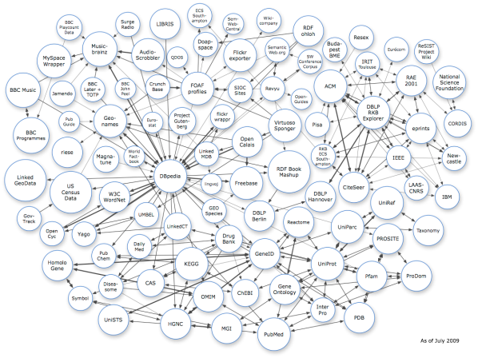
Open Data
Open Software Usage
Use open data we where able to plot a buyer map of Jamaica this map allowed for a customer to see:
The best quality
The best quantity
The person who offer’s the best rate for service
The clustering of buyers

Slide 6

Revenue

Slide 7
Source of Revenue
Freemium
This system is free however it will generate profit by providing premium services to clients and users. This will be done through:
Promoting Events
Special Advertisements
Using analytics to target intended audience
Sponsorship

Slide 8

Future Plans
Our plans for the future of UNIAccess includes:
Better User Experinece
Using more efficient data mining Algorithms
Better Business Products

Slide 9
<<Q & A>>

